Slide 1
Detail View Panels
October 24, 2014
Notes:
Guidewire training materials contain Guidewire proprietary information that is subject to confidentiality and non-disclosure agreements. You agree to use the information in this manual solely for the purpose of training to implement Guidewire software solutions. You also agree not to disclose the information in this manual to third parties or copy this manual without prior written consent from Guidewire. Guidewire training may be given only by Guidewire employees or certified Guidewire partners under the appropriate agreement with Guidewire.
<number>

Slide 2
Describe the functionality of detail view panels
Create a new detail view panel
Reference a detail view panel from a parent container
Notes:
<number>

Slide 3
Detail view panel fundamentals
Create detail view panels
Reference detail view panels
Notes:
<number>

Slide 4
Container widgets
PCF Element
Widget
Location
Atomic Widget
Container Widget
A container widget is a collection of atomic widgets and/or other container widgets
Organizes data and functionality into logical groups
Screen
Input Set
Card View Panel
Detail View Panel
List Detail Panel
List View Panel
Notes:
Container widgets hold other widgets. Each one can be defined either in its own file or as a child container within some other PCF element file.
Both Widget and Location are conceptual representations in this diagram. There are no <Widget /> or <Location /> elements. Similarly, both Atomic Widget and Container Widget are conceptual representations. There are no <Atomic Widget /> or <Container Widget /> elements.
The PCF object model is container-based. Each screen element is modeled as an object, which may contain other objects. The hierarchical structure simplifies the task of locating and modifying visual elements. Furthermore, each element can be declared as an independent and therefore reusable element.
<number>

Slide 5
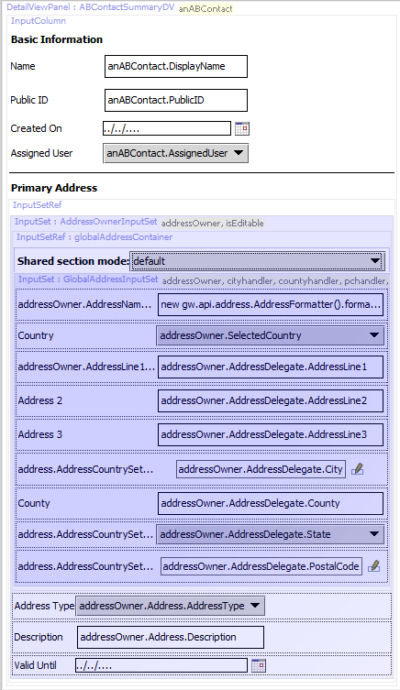
Container files are hierarchical
Top-level container
Detail View Panel
Referenced child container
Input Set
Referenced grandchild container
Input Set
Color darkens with additional nesting of included sections in PCF Editor canvas
Notes:
When viewing a container file in Studio, if it references a child container and the child container also references a child container, then the "grandchild" container appears in a dark purple shade. In other words, light purple shading denotes a child container and dark purple hading denotes a grandchild container. You can open any referenced file, regardless of whether it's a child or grandchild file, by double-clicking it. Files can be nested as deep as necessary, in which case the color of the shaded area will be progressively deeper. Double-clicking at any level will open the selected file directly. You can toggle the visibility of child files embedded in a parent PCF file. If you disable the representation of the included files, Studio displays the text of the reference expression instead.
Key features of the hierarchical structure are that you always declare one top-level container, you can declare zero to many child containers, and that you can reference zero to many containers declared in other PCFs.
PCF files are in XML format. XML is a markup that is hierarchical in nature. PCF widgets are XML elements organized into a hierarchy of elements. If you click the XML tab in the PCF Editor, you can view the XML hierarchy of XML elements. The XML view is read-only in the PCF Editor.
<number>

Slide 6
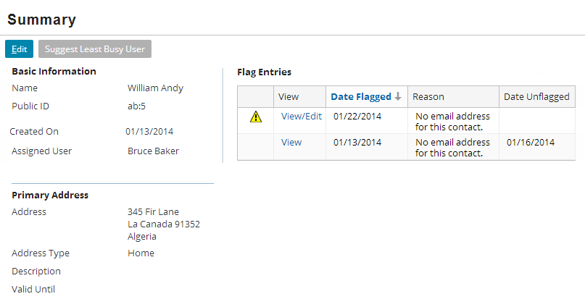
Detail view panels
ABContactSummaryDV
A detail view panel is a container widget that allows user to view, and in some cases edit, data for one object and information related to that object
Notes:
<number>

Slide 7
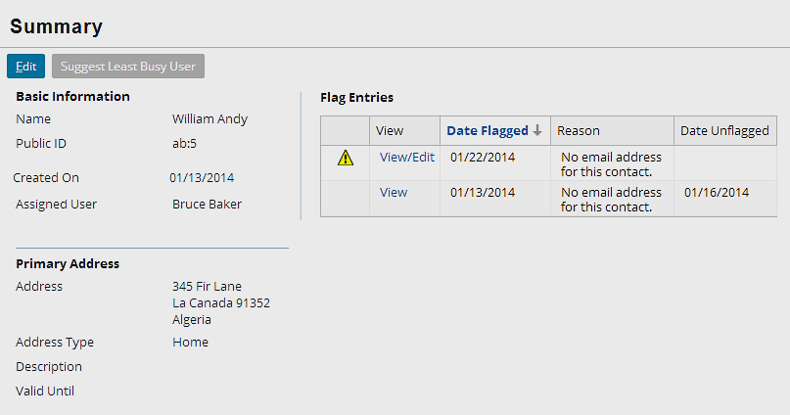
Root objects for detail view panels
ABContactSummaryDV
A detail view panel often has a root object
Container widgets typically have one root object
If referenced, a parent container must pass the root object to the detail view panel
Displays root object data with atomic widgets
Root object is anABContact of the type ABContact
Notes:
There may be multiple root objects, but more commonly a related object is referenced by a foreign key field in the root object.
It is possible to create a detail view panel that has no root objects. This sort of detail view panel could display only static labels, system information, or both, however. These types of detail view panels are therefore uncommon.
<number>

Slide 8
Detail view panel structure
Input Column
Input Column
Input columns organize layout and input widgets
Must have at least one for input widgets
Notes:
A toolbar cannot be a direct child of a detail view panel. Toolbar placement is discussed in later lessons.
In most cases, every detail view panel has atomic widgets.
Guidewire applications automatically put a vertical blue line in between input columns. This line can be seen in the slide example between the two blue rectangles.
Detail view panels may be built in a Table Layout with inputs not in columns. Table Layouts are uncommon and not covered in this course.
<number>

Slide 9
Detail view panel contents
Layout widgets
List View Panel
Containers for atomic widgets
Input Set
Layout widgets make the UI readable and user friendly
Container widgets organize
Notes:
Input widgets are widgets that display (and in some cases let end users edit) one field of data.
Layout widgets do not display data, but instead are used to make a detail view more readable and/or user-friendly. The two most commonly used widgets of this sort are label widgets, which display label text, and input divider widgets, which are rendered as horizontal lines.
Input Sets are containers for a group of input widgets.
A List View Panel is a container widget that often displays a set of rows that are related to one object or one query.
<number>

Slide 10

Resuable PCF file or inline widget
Detail View Panel PCF file
DetailViewPanel widget
Resuable PCF file
Takes a root object
File name ends with DV
Inline widget, not reusable
Inherits parent object
Exercise control over all elements
Detail View Panel PCF
Notes:
When a container such as a detail view panel is a top-level container, it is reusable. A top-level container is a PCF file. If the container is likely to be needed in multiple places, create a PCF file for the container. A Detail View Panel is PCF file that is ideal for multiple references. Other PCF files can reference the reusable container using a reference widget. In TrainingApp, the ABContactSummaryPage contains a Screen with a Panel Ref that references ABContactSummaryDV. PanelRef widgets are discussed later in this lesson.
When a container such as detail view panel is declared as an inline child container, it is not reusable. Other containers cannot reference an inline container. A DetailViewPanel widget is defined in a Screen, Card View Panel, or a List Detail Panel. It is possible to define a variable for an DetailViewPanel widget object, but this is uncommon. A DetailViewPanel widget inherits the root object associated with its parent.
<number>

Slide 11
Detail view panel fundamentals
Create detail view panels
Referencing detail view panels
Notes:
<number>

Slide 12
Steps to create a Detail View Panel PCF
Create the Detail View Panel PCF file
Specify the required variables
Optionally specify additional properties
Add input columns
Add input widgets
Deploy PCFs
* Slides do not cover the details of creating an inline Detail View Panel. See notes.
Notes:
The steps to create an inline detail view panel are the same as for a reusable detail view (PCF File), except at the very beginning.
Inline detail view panel
1. Add the DetailViewPanel widget to the parent container
2. Optionally specify additional properties
3. Add input columns
4. Add input widgets
<number>

Slide 13
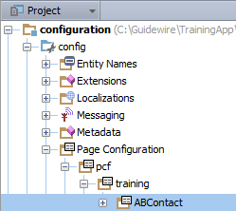
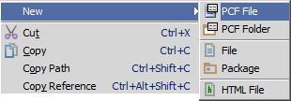
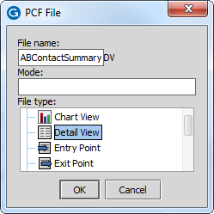
Step 1: Create a detail view panel PCF
"DV" appended to file name
In Project View, select a PCF Folder in …\config\ Page Configuration\pcf\
Context menu → New → PCF File
Enter the File Name and select Detail View as the file type in PCF File dialog
Notes:
Inline detail view panels
To create an inline detail view, find the DetailViewPanel widget in the PCF Editor toolbox. Drag the list view widget onto an existing screen, list detail panel, or card view panel.
<number>

Slide 14
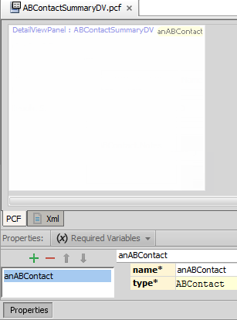
Step 2: Specify required variable(s)
Required Variables tab
Defines data object variable name and type
Example: anABContact is of type ABContact
Object data can be
Data backed (database)
Virtual property
Container data comes from defined variable object(s)
Referred to as root object
Notes:
Most container widgets have at least one required object that contains data fields. One way to think of this is that there is at least one root object for a given container.
It is possible to have more than one defined object as it is also possible to not have a required object at all.
Inline detail view panels
You do not need to specify root objects for inline detail view panel. Because a detail view panel can have only one parent container, it automatically inherits the root objects of its parent.
<number>

Slide 15
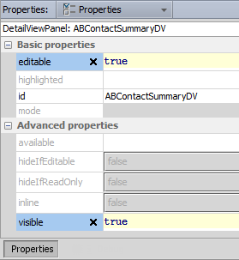
Step 3: Specify additional properties
Editable
Makes container and children widget editable
Not all container widgets have an explicit editable property
Visible
Shows container and all children
If false, then hidden
Blank is default and means that the property inherits the value from parent container or location
If not defined in hierarchy, then true
Notes:
There are two states that a detail view panel can be in: edit mode and read-only mode. If the editable property for a detail view panel is true (or blank, which defaults to true), then the detail view panel can be put into either read-only mode or edit mode. If the editable property for a detail view panel is false, then the detail view panel cannot be put into edit mode and it is always in read-only mode.
By default, there is no way to put detail view panel into edit mode. The "Editable Detail Views" lesson discusses how to add Edit | Update | Cancel buttons so that data can be modified.
Inline detail view panels
This step is the same for standalone and inline detail view panels.
<number>

Slide 16
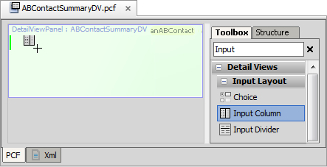
Step 4: Add input column
Light green line - current place where new widget will go
An Input Column is a single vertical column in a detail view panel that organizes atomic widgets
Notes:
In most cases, you will want add atomic widgets to a detail view panel in an organized layout. Use an input column widget to organize the atomic widgets.
To add a widget, click its name in the Toolbox and hold the mouse cursor down. As you begin to drag the widget, Studio changes the mouse cursor so that it includes the icon for that widget. Studio places a green line on the canvas at every location on the canvas that it is possible to place the widget. Studio highlights the green line that is nearest on the canvas to the cursor. Studio also overlays in green the element containing the highlighted green line.
To add an input column, locate the input column tool in the toolbox and drag it onto the canvas. If there are already input columns, dark green bars identify where the new input column could be placed, and a light green bar indicates the current place the new input column will be located.
You can skip this step by dragging an input widget onto the canvas. Studio automatically adds an input column around it if it is the first widget in the stack. It may be easier for developers who are new to PCF configuration to manually drag input columns onto the canvas to ensure that the structure of the detail view panel is correct, however.
Inline detail view panels
It is the same for reusable and inline detail view panels.
<number>

Slide 17
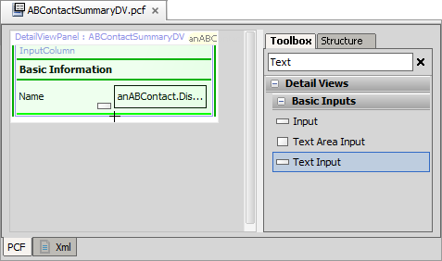
Step 5: Add atomic widgets
Light green line - current place where new widget will go
Dark green line - places where new widget can go
Select the best input for the data type from the Toolbox
Specify required and optional widget properties
Notes:
Notice that the input widgets in the slide example reference the ABContact object as anABContact. The variable name of the root object is anABContact. Input widgets must reference object as named on Required Variables tab.
The "Atomic Widgets" lesson discuss adding input widgets and defining the properties on atomic widgets.
Inline detail view panels
It is the same for reusable and inline detail view panels.
<number>

Slide 18
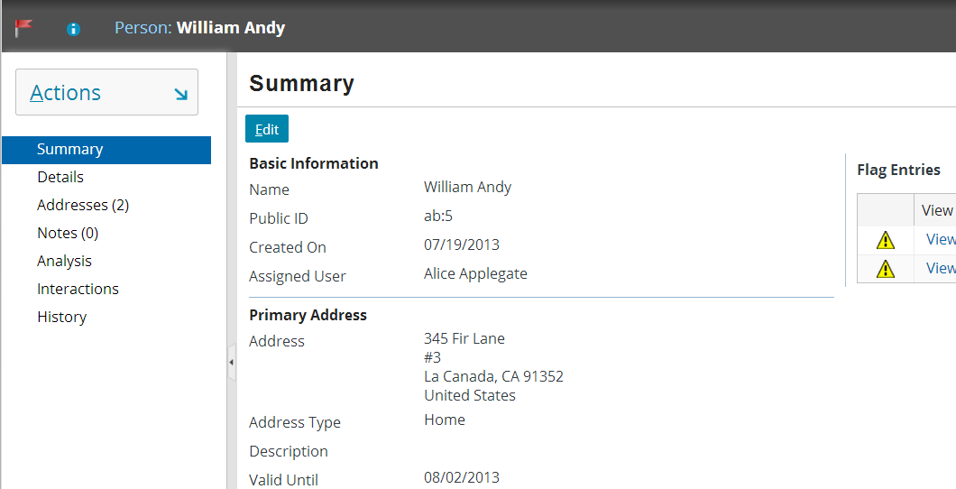
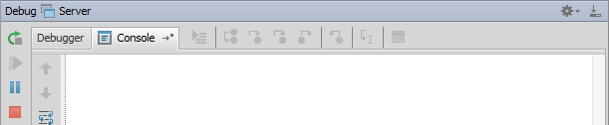
Internal debug tools: Reload PCFs ALT+SHIFT+L
ALT+SHIFT+L
2014-01-13 15:16:06,573 INFO PCFs reloaded.
Reloads all Page Configuration Files
Command window or Guidewire Studio Console window (Debug / Run) details output
Notes:
If you are running an open application project in Guidewire Studio and if internal tools are enabled, you can reload all the page configuration files for the server.
If you reload PCF files while in edit mode, you may experience unpredictable results. For the current location, where there is a data modification in progress, the new PCFs may not be reloaded. Therefore, Guidewire recommends reloading PCF files while in read-only mode as it provides for more predictable results.
<number>

Slide 19
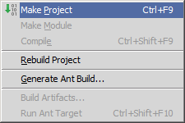
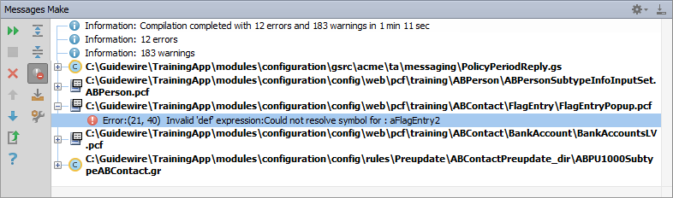
Make project to see all PCF errors
Build → Make Project
Compiles only modified files since the last compilation
Opens Messages (Make) window for build summary
Filter for errors
Great way to see all PCF errors
Notes:
Make Project: All the source files in the entire project that have been modified since the last compilation are compiled. Dependent source files, if appropriate, are also compiled. Additionally, the tasks tied to the compilation or make process on modified sources are performed.
<number>

Slide 20
Step 6: Deploy PCFs
Restart Server
Reload PCFs
PCFs read at server startup
ALT+SHIFT+L
Internal debug tools enabled
Internal Tools
Reload → Reload PCF Files
Page Configuration File
Detail View Panel PCF
Page Configuration File
Detail View Panel PCF
Notes:
It is also possible to reload PCF files using the Guidewire API and/or internal server tools. The Reload PCF command can be found on the Reload page in Internal Tools. To access Internal Tools, you must log in as an administrator user, e.g., su/gw. Then, use ALT+SHIFT+T. In the tab bar, select Internal Tools → Reload. On the Reload page, click the Reload PCF Files button. The Reload PCF Files button calls the static method gw.api.tools.InternalToolsUtil.reloadPCFs().
Inline detail view panels
This step is the same for standalone and inline detail view panels. However, for inline detail view panels, only the location PCF files get deployed.
<number>

Slide 21
Detail view panel fundamentals
Creating detail view panels
Reference detail view panels
Notes:
<number>

Slide 22
Referencing detail view panels
Screen
A reference widget in a parent container references a PCF File as an embedded child container
A PanelRef widget can reference:
Detail View Panel
List View Panel
Card View Panel
List Detail Panel
Card View Panel / List Detail Panel
Panel Ref
Detail View Panel
List View Panel
Input Set
Atomic Widgets
Notes:
Detail view panels can be referenced by three types of containers: screens, card view panels and list detail panels.
The methods for referencing a list view panel in a screen, card view panel or list detail panels is identical: you use a PanelRef widget.
Input Sets are covered in the "Input Sets" lesson. List views are covered in the "List Views" lessons.
<number>

Slide 23
Panel Ref
Panel Ref
Detail View Panel
A Panel Ref includes a reference to a "panel" container
Card View Panel, Detail View Panel, List Detail Panel, List View Panel, or Panel Set
Optionally supplies referenced panel with Title, Toolbar, Help Text
Notes:
A Panel Ref requires a reference to a panel such as a Detail View Panel, List View Panel, Panel Set, or Card View Panel. A Panel Ref supplies the referenced panel with title, toolbar or instructional text.
<number>

Slide 24
Steps to reference a detail view panel
Add PanelRef widget
Specify widget properties
Deploy PCFs
Notes:
It is not possible to add a reference to an inline detail view panel.
<number>

Slide 25
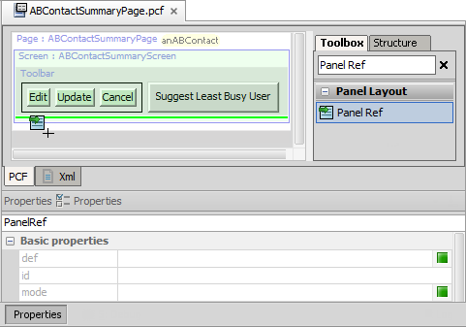
Step 1: Add panel ref
Add a PanelRef widget to the parent container
Panel Ref requires a def property value
def property identifies the name of panel to reference and object to pass as root object
Notes:
A PanelRef widget can reference a detail view panel. To reference a detail view panel from a parent container, add a Panel Ref in the appropriate place in the parent container.
In the slide example, the Panel Ref has already been placed in the Screen in the PCF editor canvas. The Properties window shows the Properties tab of the Panel Ref.
<number>

Slide 26
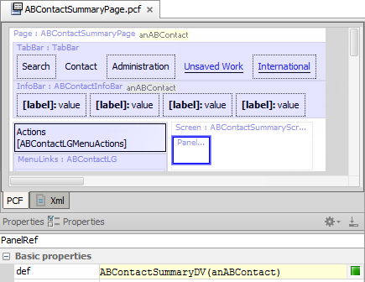
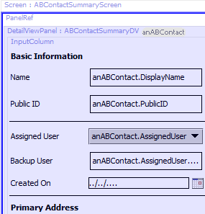
Step 3: Reference the detail view panel
Detail View Panel
root object
Define the def property
Specify the detail view panel PCF file
Pass the required object type as an argument
Notes:
In the panel ref's def property, specify the detail view panel name. After the name, inside parentheses, specify the required object(s) to pass to the detail view panel.
In the slide example, ABContactSummaryPage defines a root object named anABContact. ABContactSummaryPage contains a newly added Panel Ref. The Panel Ref requires a value for the def property. The def property references the Detail View Panel named ABContactSummaryDV. The def property passes the anABContact root object as an argument to ABContactSummaryDV.
The toolbar in the slide example has been removed in the screenshot.
<number>

Slide 27
Make project to see all PCF errors
Build → Make Project
Compiles only modified files since the last compilation
Opens Messages (Make) window for build summary
Filter for errors
Great way to see all PCF errors
Notes:
Make Project: All the source files in the entire project that have been modified since the last compilation are compiled. Dependent source files, if appropriate, are also compiled. Additionally, the tasks tied to the compilation or make process on modified sources are performed.
<number>

Slide 28
Step 3: Deploy PCFs
Restart Server
Reload PCFs
PCFs read at server startup
ALT+SHIFT+L
Internal debug tools enabled
Internal Tools
Reload → Reload PCF Files
Page Configuration File
Detail View Panel PCF
Page Configuration File
Detail View Panel PCF
Notes:
It is also possible to reload PCF files using the Guidewire API and/or internal server tools. The Reload PCF command can be found on the Reload page in Internal Tools. To access Internal Tools, you must log in as an administrator user, e.g., su/gw. Then, use ALT+SHIFT+T. In the tab bar, select Internal Tools → Reload. On the Reload page, click the Reload PCF Files button. The Reload PCF Files button calls the static method gw.api.tools.InternalToolsUtil.reloadPCFs().
<number>

Slide 29
Detail view panel in read-only mode
Toolbar and Edit Buttons
By default, there is no way to put detail view into edit mode
Next lesson discusses how to add Edit|Update buttons so that data can be modified
Notes:
<number>

Slide 30
Describe the functionality of detail view panels
Create a new detail view panel
Reference a detail view panel from a parent container
Notes:
<number>

Slide 31
A detail view panel that displays data must have at least one root object. Why?
A detail view panel that displays data must have at least one input column. Why?
What are the two most common types of widgets used to lay out a detail view panel so that it is more usable to end users?
What determines if a detail view panel is reusable or not?
The def property of a panel ref usually has a value in the format of "x(y)"
What information comes before the parenthesis? (What is the x?)
What information is defined within the parenthesis? (What is the y?)
Notes:
Answers
1) The input widgets of a detail view panel must reference some object in order to specify where the data they display comes from. This object must be the root object, or an object related to the root object. Therefore, in order to display data, a root object is needed.
2) Input columns are used to organize atomic widgets in a detail view panel. Every input widget must be in an input column. If a detail view panel displays data, then it has at least one input widget, which means it must have at least one input column.
3) Label and input divider.
4) If a detail view panel is declared as the parent object of a PCF file, then it is reusable. It can be referenced by any number of other containers.
5a) The x is the name of the container to reference.
5b) The y is a list of objects to pass to the child container to use as root objects.
<number>

Slide 32
Notes:
<number>

